Slide 1
Team Cinco
Amber Moran - Andrew Haug - Mark Rudolph -Sam Guzman - Sam Lin

Slide 2

Motivation
Hired by a consulting firm we are asked to examine the return on investment for vacation rentals in 5 major cities.

Slide 3
Summary
What are the costs associated with each city?
Median house price per city?
Bedrooms per house?
Count of listings (Competition) in each city?
What are the benefits associated with short term rentals in each city?
Median rental price per night?
Count of nights rented per year (Occupancy rate)?
Return on investment? ROI per house by bedroom count?
Comparing our costs to our benefits which city offers the greatest return on investment?

Slide 4





Investment Cities
Austin
Boston
Chicago
San Diego
Seattle

Slide 5



Data Collection
Sources needed:
Home Market Values
Realtor.com
Vacation Rental Values
Inside Airbnb

Slide 6
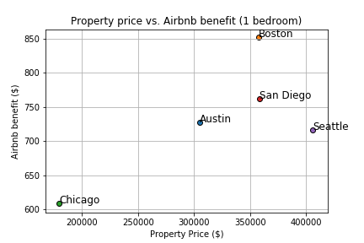
Scatter 1 Bedroom

Slide 7
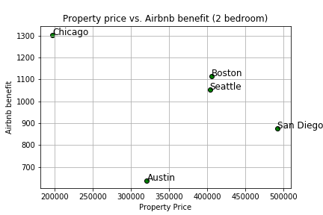
Scatter 2 Bedroom

Slide 8
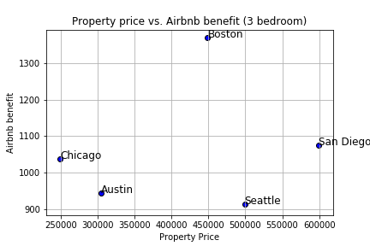
Scatter 3 Bedroom

Slide 9
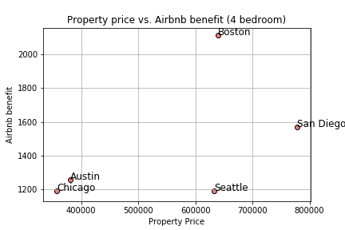
Scatter 4 Bedroom

Slide 10
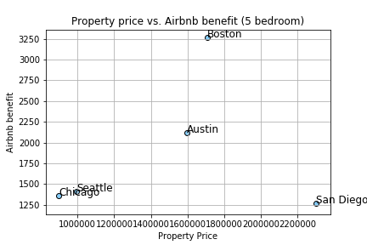
Scatter 5 Bedroom

Slide 11
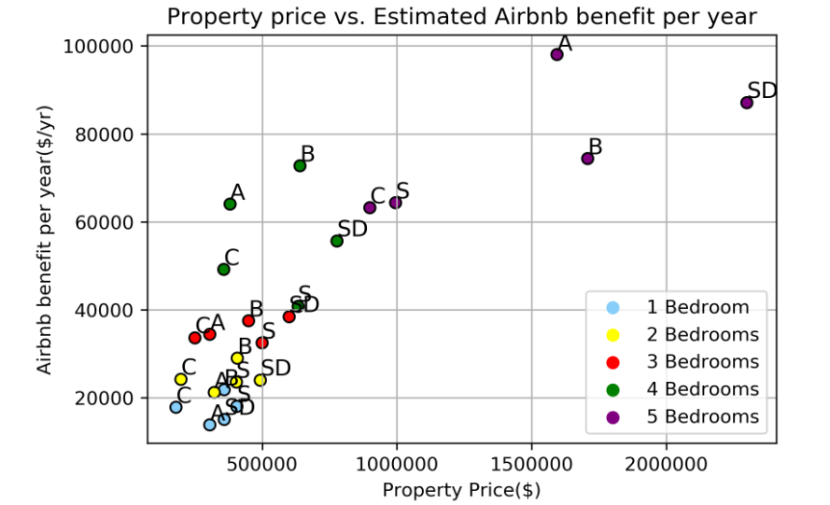
Total Scatterplot

Slide 12
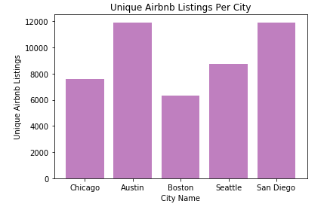
Airbnb listings per city

Slide 13
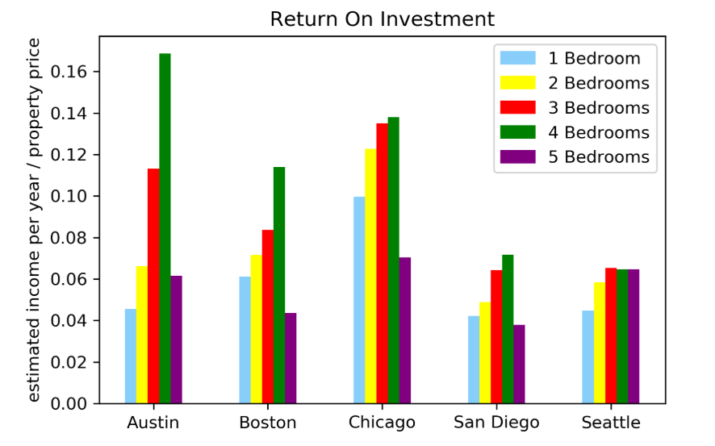
Return on Investment

Slide 14

Conclusions
Based on overall return on investment
Chicago
Austin
Boston
Seattle
San Diego

Slide 15
Conclusions/Observations
Chicago provides the greatest return on investment when looking at all bedroom types
The 3 and 4 Bedroom homes gain our strongest recommendations
The best individual return on investment is Austin’s 4 Bedrooms. The worst investment is San Diego’s 5 Bedroom homes.
For 4 out of the 5 cities the 4 Bedroom home provided the highest return on investment
As the count of bedrooms increases, the data points become less clustered.
Austin (11919) and San Diego (11922) had the most unique listings and were only separated by 3 total listings!

Slide 16
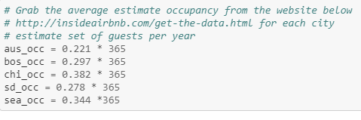
Data Obstacles
Our original data collection did not include occupancy rates on the csv files.
We found the statistics for occupancy rate in each city on the front end of Inside Airbnb’s website
Using that data we were able to create a new column and merge it into our data frame before we plotted our graphs

Slide 17
Post Mortem
What would we research next or more in detail if we had more time?
More cities?
Breakdown zip codes in each city?
Examine outliers (great sales weekends vs slow seasons)?
Long term rental markets return on investment
Exit strategy or ability to sell quickly and at what value?

Slide 18
Questions & Answers

Slide 19
Resources
Airbnb - http://insideairbnb.com/get-the-data.html
Realtor - https://www.realtor.com/research/data/
Jupyter Notebook - https://github.com/chinosamg/Cinco

Slide 20
* Title Slide
* Include the name of the Project and Group Members
* Motivation & Summary Slide
* Define the core message or hypothesis of your project.
* Describe the questions you asked, and _why_ you asked them
* Describe whether you were able to answer these questions to your satisfaction, and briefly summarize your findings
* Questions & Data
* Elaborate on the questions you asked, describing what kinds of data you needed to answer them, and where you found it
* Data Cleanup & Exploration
* Describe the exploration and cleanup process
* Discuss insights you had while exploring the data that you didn't anticipate
* Discuss any problems that arose after exploring the data, and how you resolved them
* Present and discuss interesting figures developed during exploration, ideally with the help of Jupyter Notebook
* Data Analysis
* Discuss the steps you took to analyze the data and answer each question you asked in your proposal
* Present and discuss interesting figures developed during analysis, ideally with the help of Jupyter Notebook
* Discussion
* Discuss your findings. Did you find what you expected to find? If not, why not? What inferences or general conclusions can you draw from your analysis?
* Post Mortem
* Discuss any difficulties that arose, and how you dealt with them
* Discuss any additional questions that came up, but which you didn't have time to answer: What would you research next, if you had two more weeks?
* Questions
* Open-floor Q&A with the audience

Slide 21
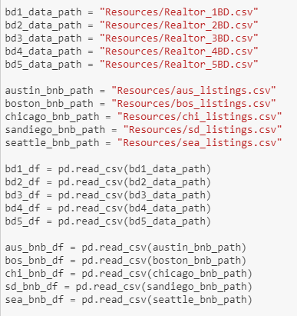
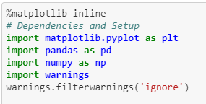
Coding Skills
Imported csv files
Panda for data frames
Matplotlib for graphs

Slide 22

Data Cleanup
Our first step was to drop all other cities other than Austin, Boston, Chicago, San Diego and Seattle
Csv data was only available by bedroom, so we ran 5 different analysis and merged together at the end
Example shown 1 Bedroom

Slide 23
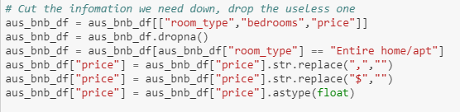
Data Cleanup
Breaking down price per night off inside Airbnb required each city to be imported alone and merged
Example code for Austin

Slide 24
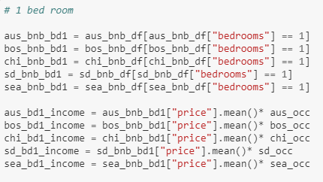
Data Cleanup
The csv files we used for inside Airbnb did not include occupancy rate
Using the occupancy rate found on another section of the website
We calculated price per night * occupancy rate = potential annual income

Slide 25
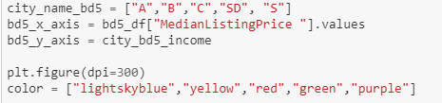
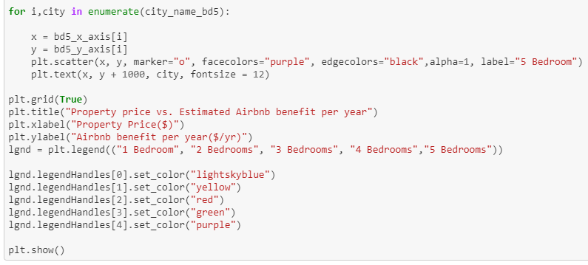
Data Cleanup
We created a scatterplot showing all 5 cities and 1-5 bedrooms median price
We shortened the display name of each city:
A = Austin
B = Boston
C = Chicago
SD = San Diego
S = Seattle

Slide 26
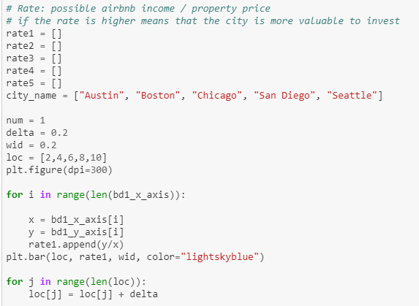
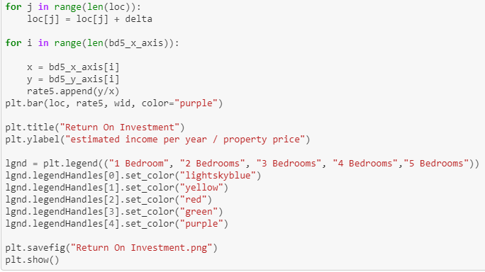
Data Cleanup
Created a bar graph to illustrate return on investment ratio for each bedroom and labeled each city

Slide 27
* Data Analysis
* Discuss the steps you took to analyze the data and answer each question you asked in your proposal
* Present and discuss interesting figures developed during analysis, ideally with the help of Jupyter Notebook

Slide 28
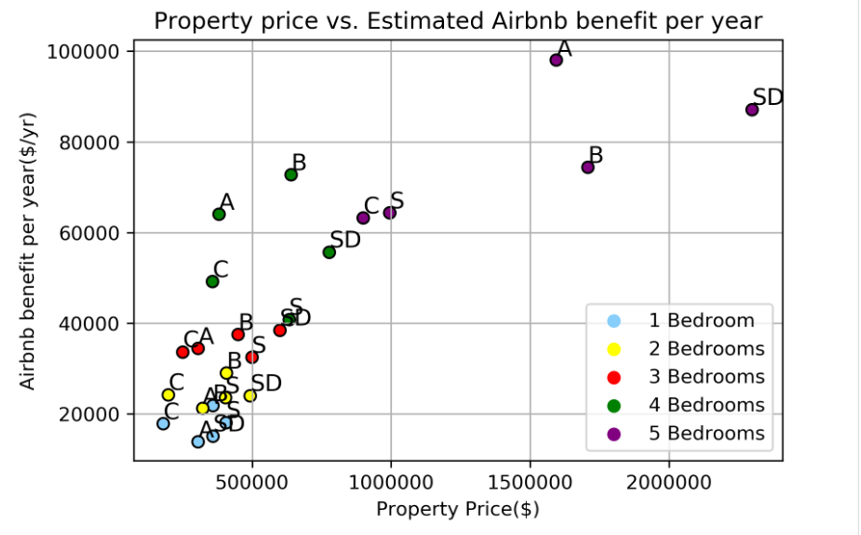
Discussion
* Discuss your findings. Did you find what you expected to find? If not, why not? What inferences or general conclusions can you draw from your analysis?
We expected to see a positive correlation between property price and benefit of renting price
We were correct for the most part, but surprised by some of the 4 bedroom results.

Slide 29
* Post Mortem
* Discuss any difficulties that arose, and how you dealt with them
* Discuss any additional questions that came up, but which you didn't have time to answer: What would you research next, if you had two more weeks?

Slide 30
Post Mortem
We had more trouble than we first thought on finding the occupancy rate. After using searching our csv files we realized the data was readily available.
So using statistics from another part of the website we were able to find the occupancy rates, carucate each cities rate and add a column back into our dataframe before plotting our results.

Slide 31
* Questions & Data
* Elaborate on the questions you asked, describing what kinds of data you needed to answer them, and where you found it

Slide 32
* Data Cleanup & Exploration
* Describe the exploration and cleanup process
* Discuss insights you had while exploring the data that you didn't anticipate
* Discuss any problems that arose after exploring the data, and how you resolved them
* Present and discuss interesting figures developed during exploration, ideally with the help of Jupyter Notebook

